Slide 1



DATA ANALYSIS
PROJECT
Presented by: Deepti Deepti

Slide 2





OVERVIEW
SLIDE 1: LIFECYCLE
SLIDE 2: REQUIREMENTS
Names stages of data lifecycle
Activities before project
Adapting to data changes
Primary involvement in analysis
Project's place in data lifecycle
Process from requirements to design
Ensuring design meets business needs
Techniques for clearer design

Slide 3


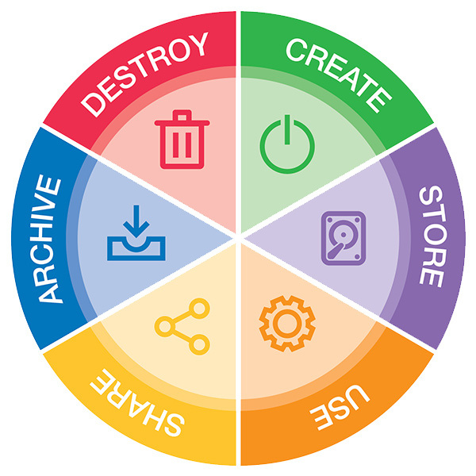
DATA LIFECYCLE

Slide 4

LIFECYLCE
Stages of the Data Lifecycle
The data lifecycle consists of several stages including data collection, storage, processing, analysis, and visualization.
Before starting this project, we would need to conduct data sourcing, extraction, and cleaning to ensure the data is accurate and relevant.
Pre-Project Activities
Handling Data Changes
If the data changes, we would need to update our data sources, recalibrate our analysis, and potentially modify our visualizations to reflect the new data.
In this project, our primary focus is on data analysis and visualization, specifically creating dashboards to present project performance metrics.
Project
Involvement
Project in the Data Lifecycle
Our project fits into the broader data lifecycle by contributing to the analysis and interpretation stage, where data is transformed into actionable insights to drive decision-making.

Slide 5






REQUIREMENTS
Design Process Summary
Gathered business requirements from Sophie and team.
Translated requirements into a structured dashboard blueprint.
Obtained approval from Sophie to ensure alignment with expectations.
Ensuring Design Meets Business Needs
Conducted regular reviews and feedback sessions with Sophie.
Incorporated key performance indicators (KPIs) and user requirements into the dashboard design.
Ensured dashboard functionality and usability for Sophie and other stakeholders.
Techniques for Clearer Design
Used intuitive data visualizations to convey information effectively.
Implemented user-friendly features such as filters and tooltips for interactive exploration.
Maintained consistency in design elements and layout for easy navigation.

Slide 6


Thanks!
Any Questions?

